Slide 1

Pizza Sales Analysis Using SQL

Slide 2



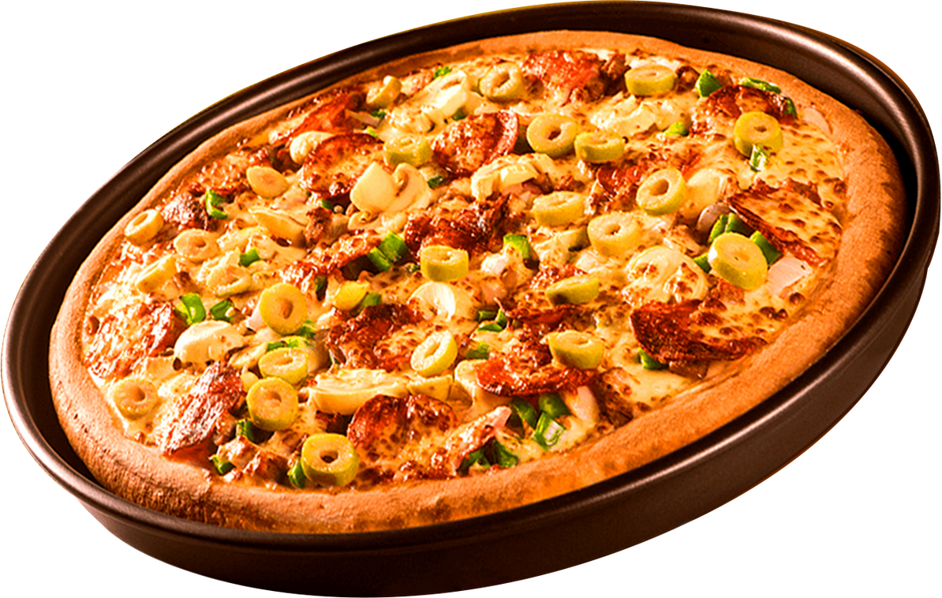

Introduction to
Pizza Sales Analysis Using SQL
In this project, we utilize SQL to analyze pizza sales data, uncover trends, and derive insights that can enhance business decision-making. By leveraging SQL queries, we extract valuable information such as total revenue, top-selling pizzas, peak order times, and customer purchase behavior
The analysis consists of three levels:
Basic Queries: These retrieve fundamental metrics like total orders, revenue, and the most popular pizzas.
Intermediate Queries: We join tables to explore deeper insights, such as category-wise distributions and revenue trends over time.
Advanced Queries: These include percentage contributions to total revenue and cumulative revenue analysis, providing strategic business insights.

Slide 3
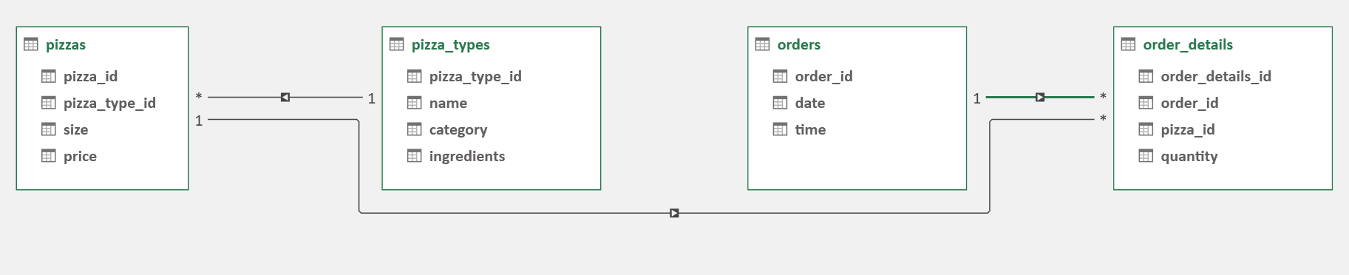
SCHEMA

Slide 4
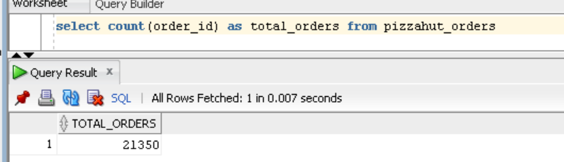
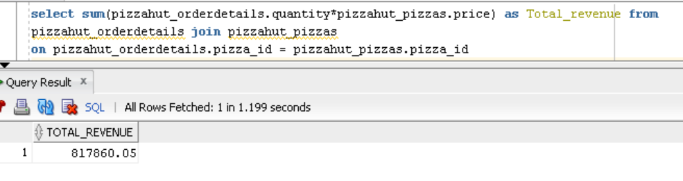
Basic
1.Retrieve the total number of orders placed
2.Calculate the total revenue generated from pizza sales.

Slide 5
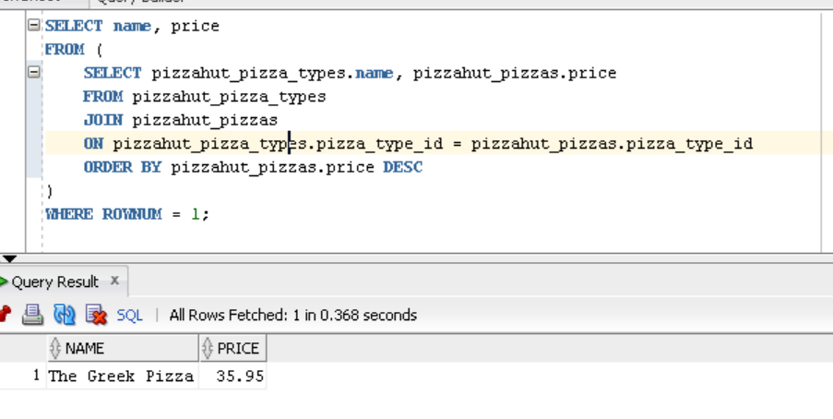
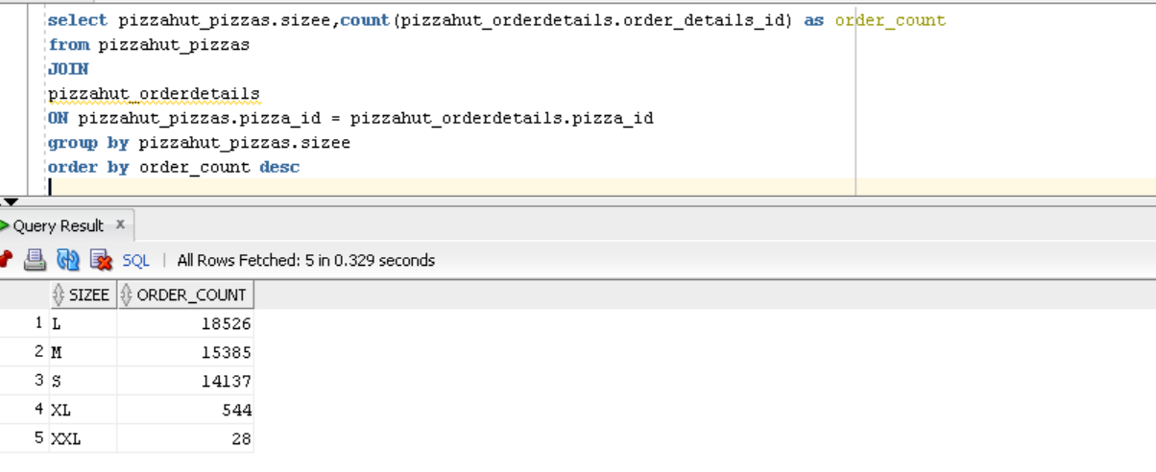
3.Identify the highest-priced pizza.
4.Identify the most common pizza size ordered

Slide 6
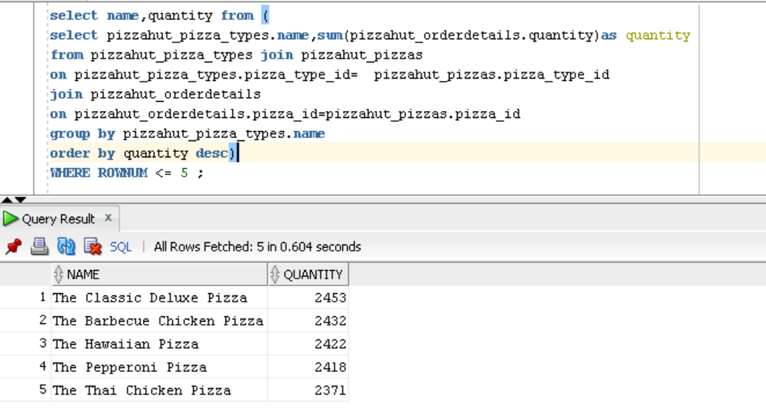
5.List the top 5 most ordered pizza types along with their quantities.

Slide 7
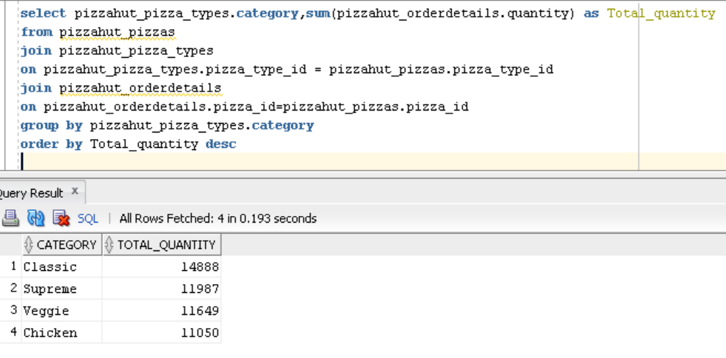
Intermediate
6.Join the necessary tables to find the total quantity of each pizza category ordered.

Slide 8
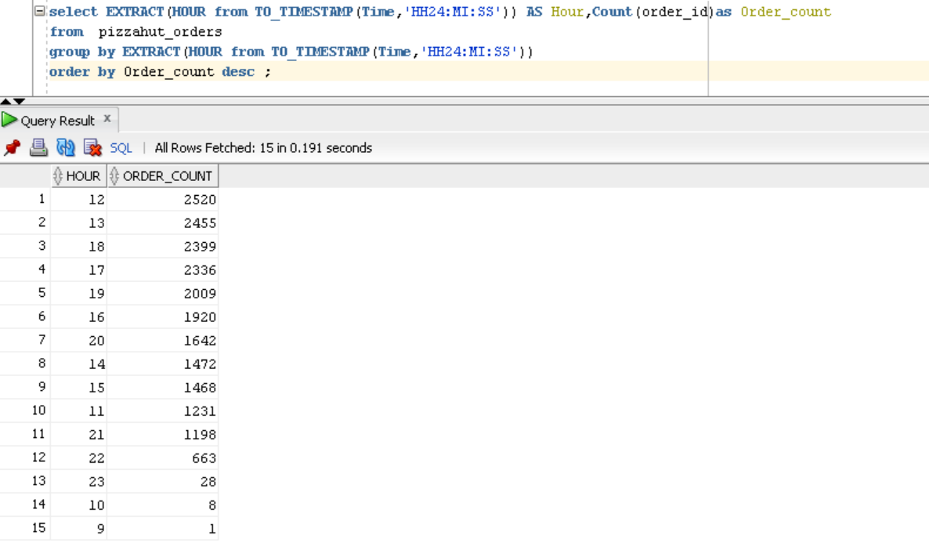
7.Determine the distribution of orders by hour of the day.

Slide 9
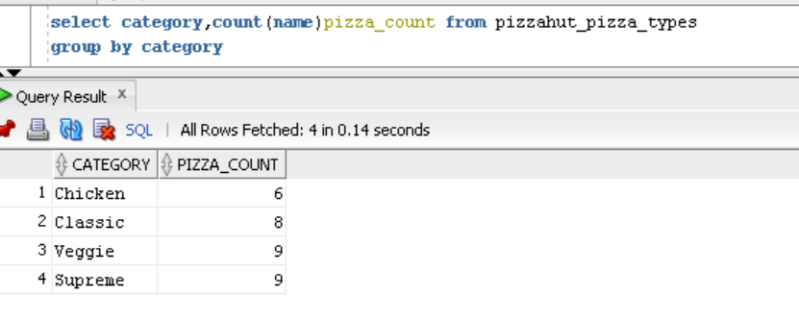
8.Join relevant tables to find the category-wise distribution of pizzas.

Slide 10
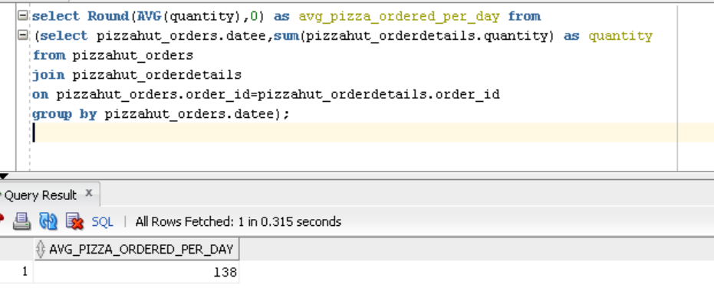
9.Group the orders by date and calculate the average number of pizzas ordered per day.

Slide 11
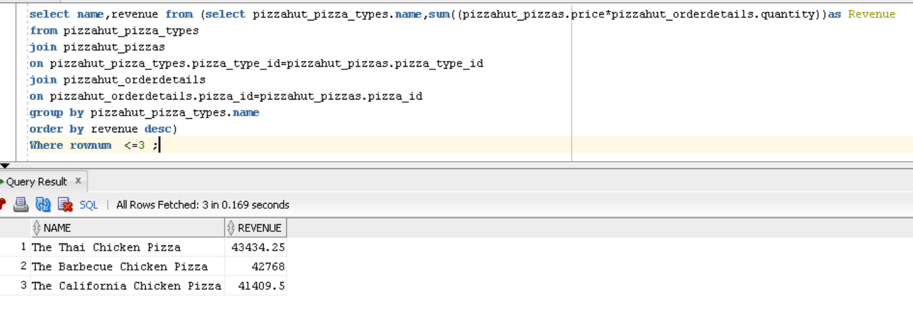
10.Determine the top 3 most ordered pizza types based on revenue.

Slide 12
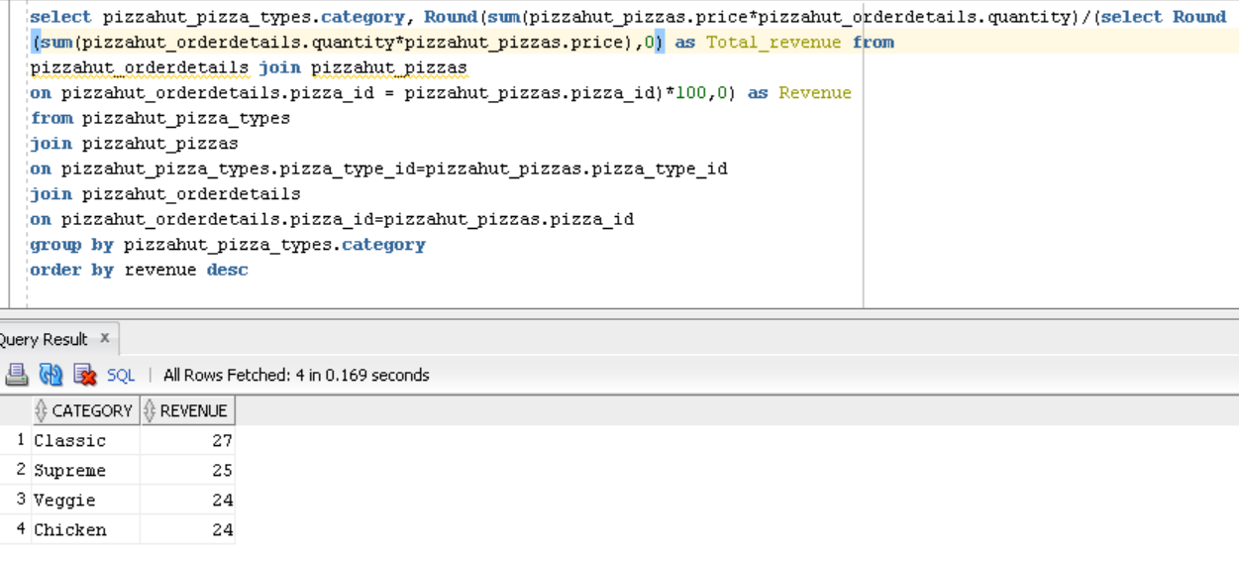
Advanced
11.Calculate the percentage contribution of each pizza type to total revenue.

Slide 13
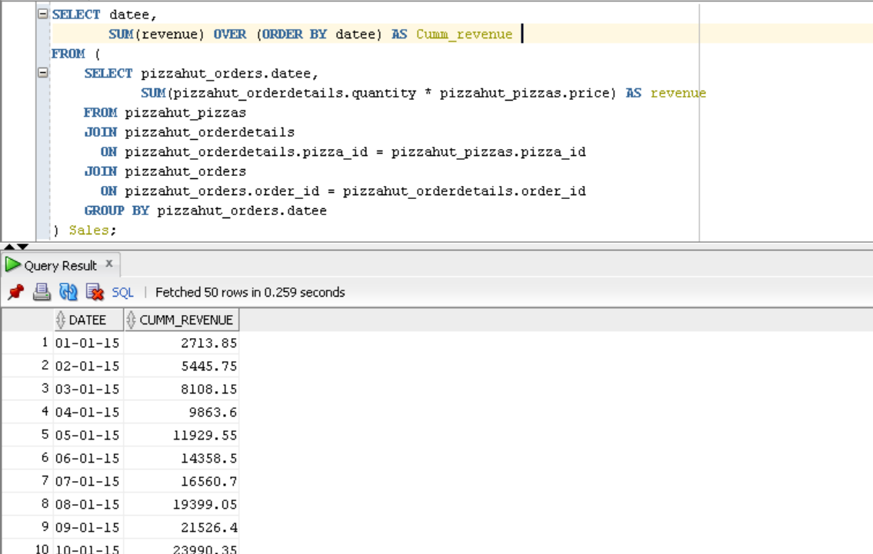
12.Analyze the cumulative revenue generated over time.

Slide 14
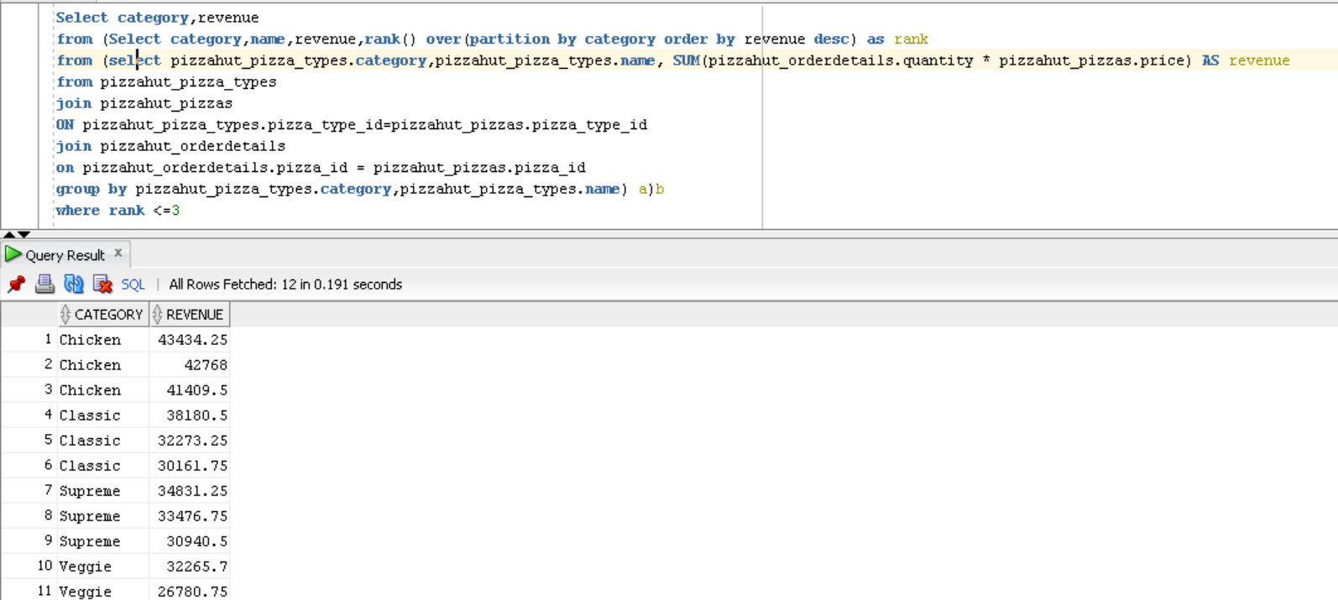
13.Determine the top 3 most ordered pizza types based on revenue for each pizza category.

